Slide 1
The Game in Numbers: Analyzing Football Data from Transfermarkt
By Ibrahim Ibrahim

Slide 2

Agenda
Age Distributions of Football Players
Player Valuation Trends Over Time
Performance Differentials: Home vs. Away in Top 5 Leagues
Analysis of Goals Based on Field Position
Player Density in Domestic Competitions

Slide 3
What is the Transfermarkt dataset?
1
60,000+
Games from many seasons on all major competitions
2
30,000+
Players from 400+ clubs
3
1,200,000+
Player appearance records from all games
Notes:
Diagram design of the database:
https://drawsql.app/teams/ibrahim-9/diagrams/the-game-in-numbers-analyzing-football-data-from-transfermarkt

Slide 4
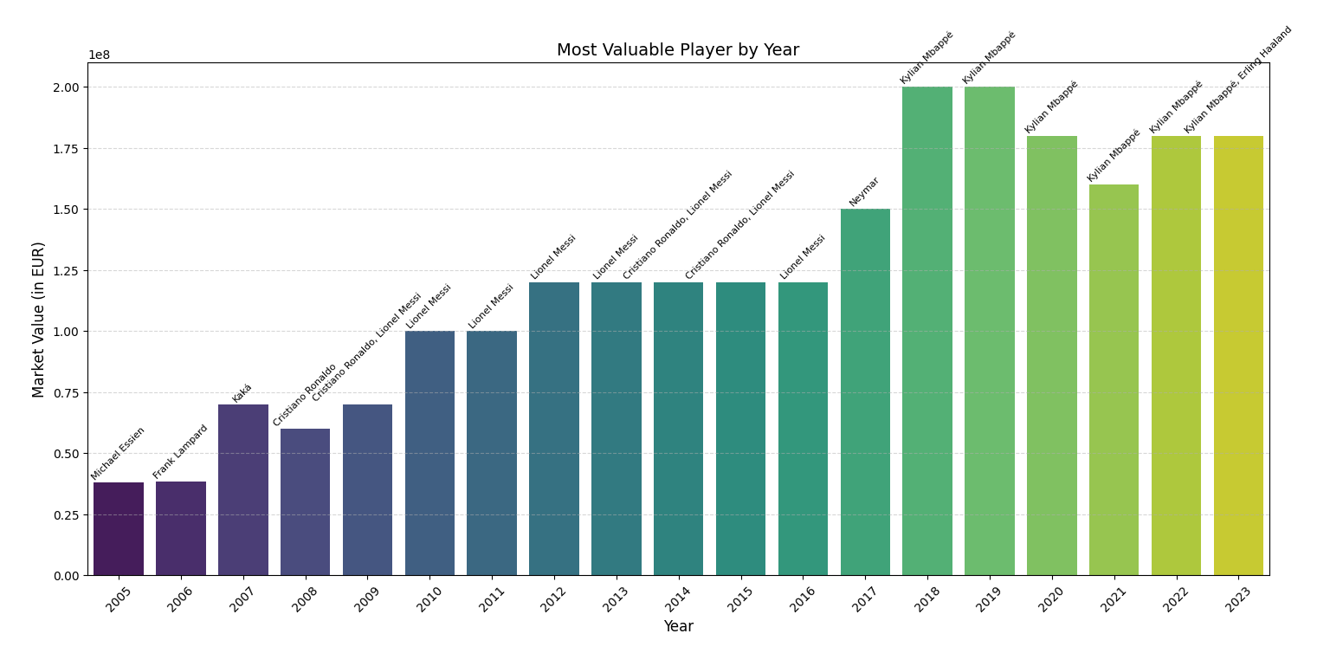
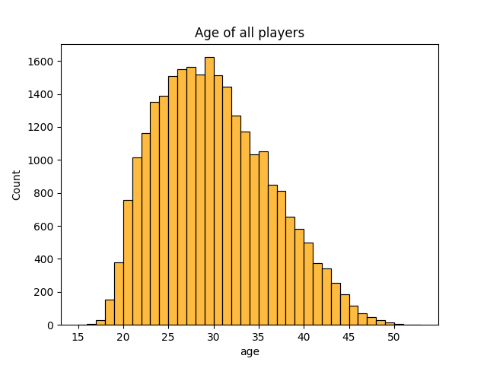
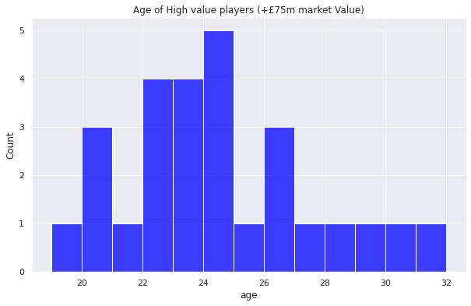
Notes:
The market value of the most valuable player has been increasing over time, from 1992 to 2021. This could be due to various factors such as inflation, increased revenues in football, and the growing global popularity of the sport.

Slide 5
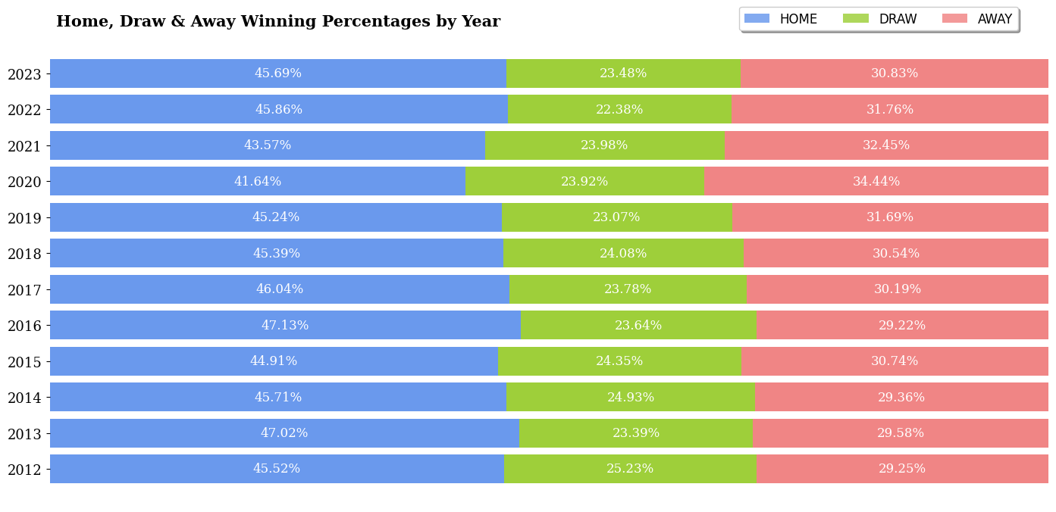
Notes:
The chart shows that home teams have a significant advantage over away teams, with home winning percentages consistently higher than away winning percentages. Draw percentages have remained relatively stable over the years, fluctuating between 23% and 25%.
One meaningful insight that can be drawn from this chart is that home teams have a better chance of winning because they are playing in familiar surroundings and with the support of their home fans. This is known as the "home field advantage.“
Draw percentages have remained relatively stable over the years, fluctuating between 23% and 25%. This suggests that there is a fundamental balance between home teams and away teams, and that neither side is consistently able to gain a significant advantage over the other.
The gap between home and away winning percentages has narrowed slightly in recent years. This could be due to a number of factors, such as the increasing professionalism of away teams, the improved quality of playing surfaces in away stadiums, and the impact of technology such as video assistant referees (VAR).

Slide 6
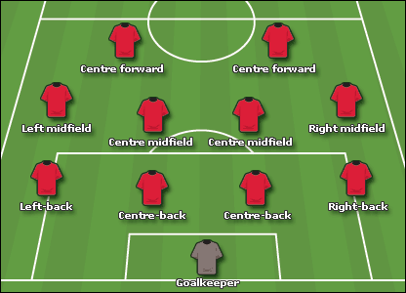
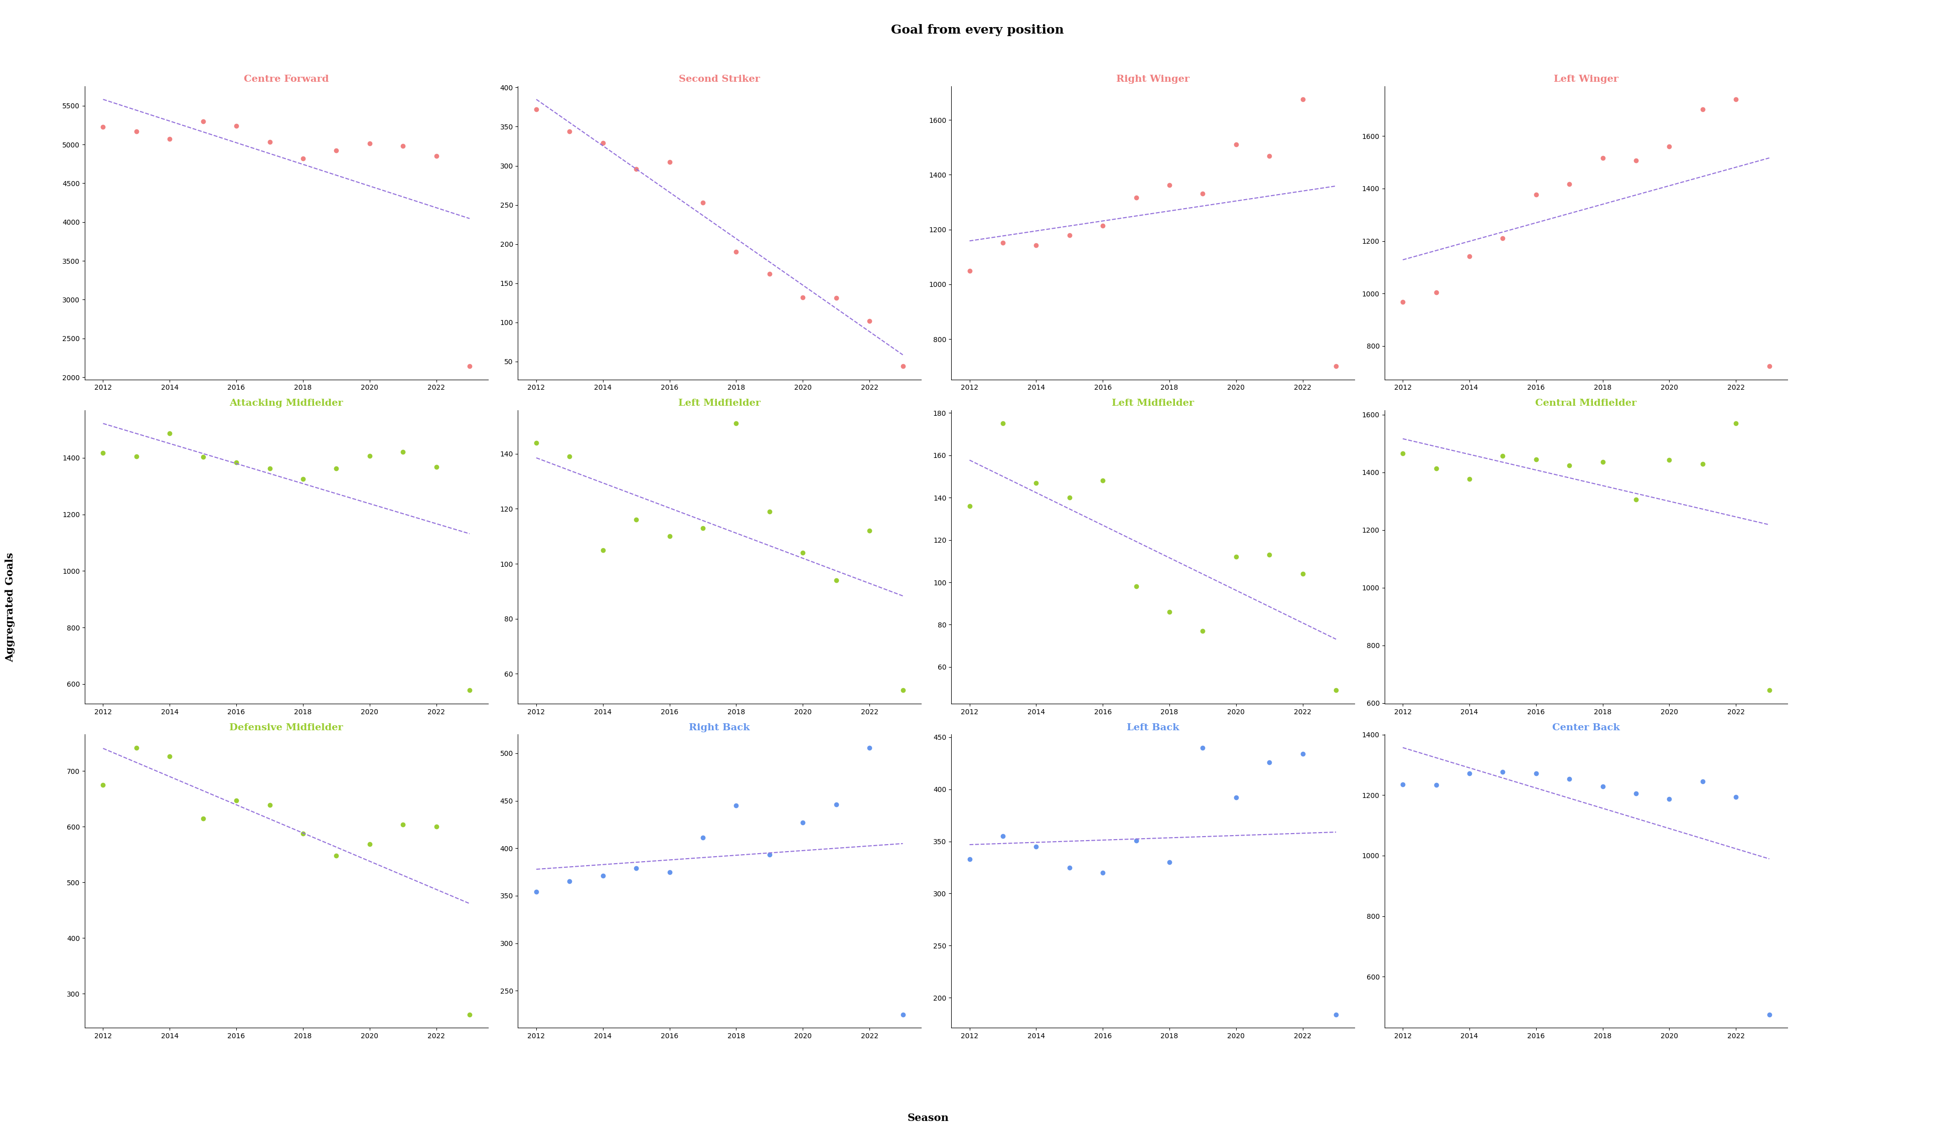
Notes:
Attackers are the most prolific goalscorers. This is because these players are typically positioned closest to the opponent's goal and have the most opportunities to score.
Midfielders also score a significant number of goals. Attacking Midfielders and Right Midfielders are the most prolific goalscoring midfielders,
followed by Central Midfielders and Defensive Midfielders. This is because these players are often involved in the build-up to goals and are also capable of scoring long-range goals or goals from set pieces.
Defenders score the fewest goals. However, it is important to note that defenders play a different role Their primary focus is to prevent the opposition from scoring goals, rather than scoring goals themselves.
The plot also shows some interesting trends over time. For example, the number of goals scored by Attacking Midfielders has increased in recent years. This could be due to a number of factors, such as the increasing popularity of attacking formations and the increasing number of teams using attacking midfielders as playmakers.

Slide 7
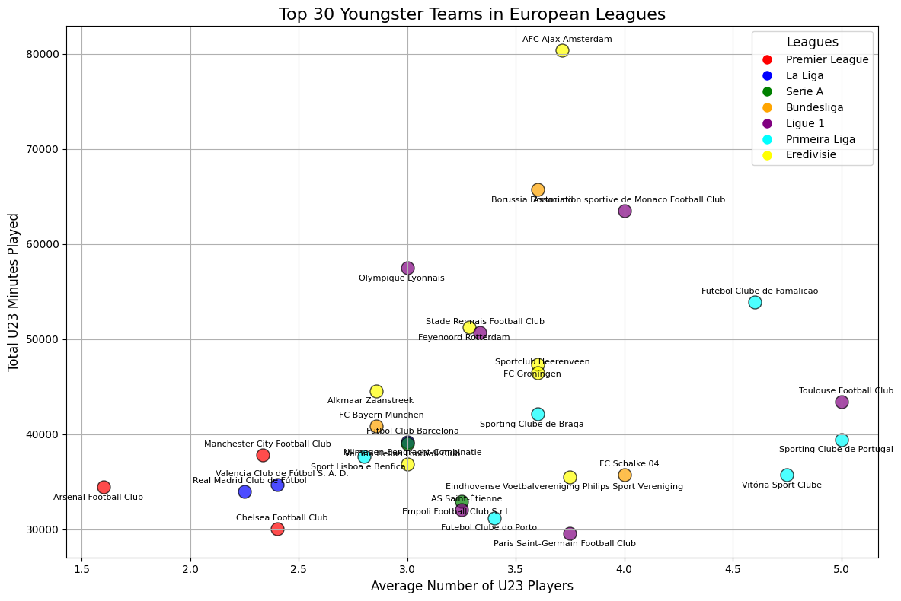
Notes:
The plot shows the average number of U23 players and the total U23 minutes played for the top 30 teams in the seven major European leagues. The teams are colored by league, and the plot also includes a legend with league names.
This suggests that there is a correlation between giving U23 players opportunities and developing them into successful players.
The teams in the Bundesliga and the Eredivisie give U23 players the most minutes on average. This suggests that these leagues are more willing to trust young players with important roles.
There are a few teams that stand out from the others. For example, AFC Ajax Amsterdam plays an average of 8 U23 players per game and gives U23 players an average of 70,000 minutes per season. This is significantly more than the average for the other teams in the Eredivisie.

Slide 8
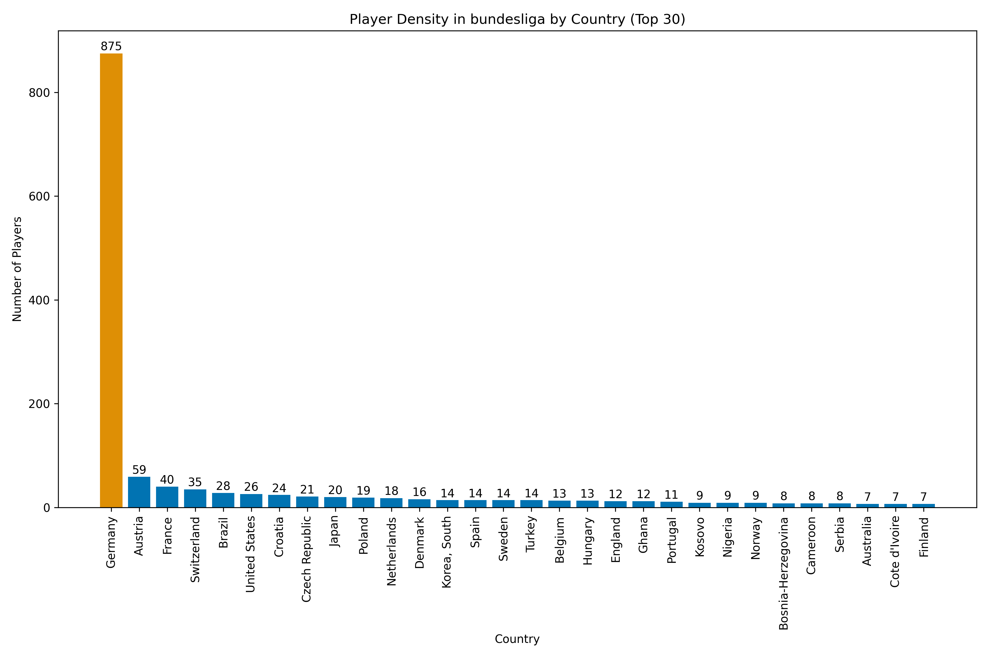

Notes:
Language and Culture: Language and cultural familiarity can play a significant role. Players might prefer to play in a league where they are comfortable with the language and culture.

Slide 9
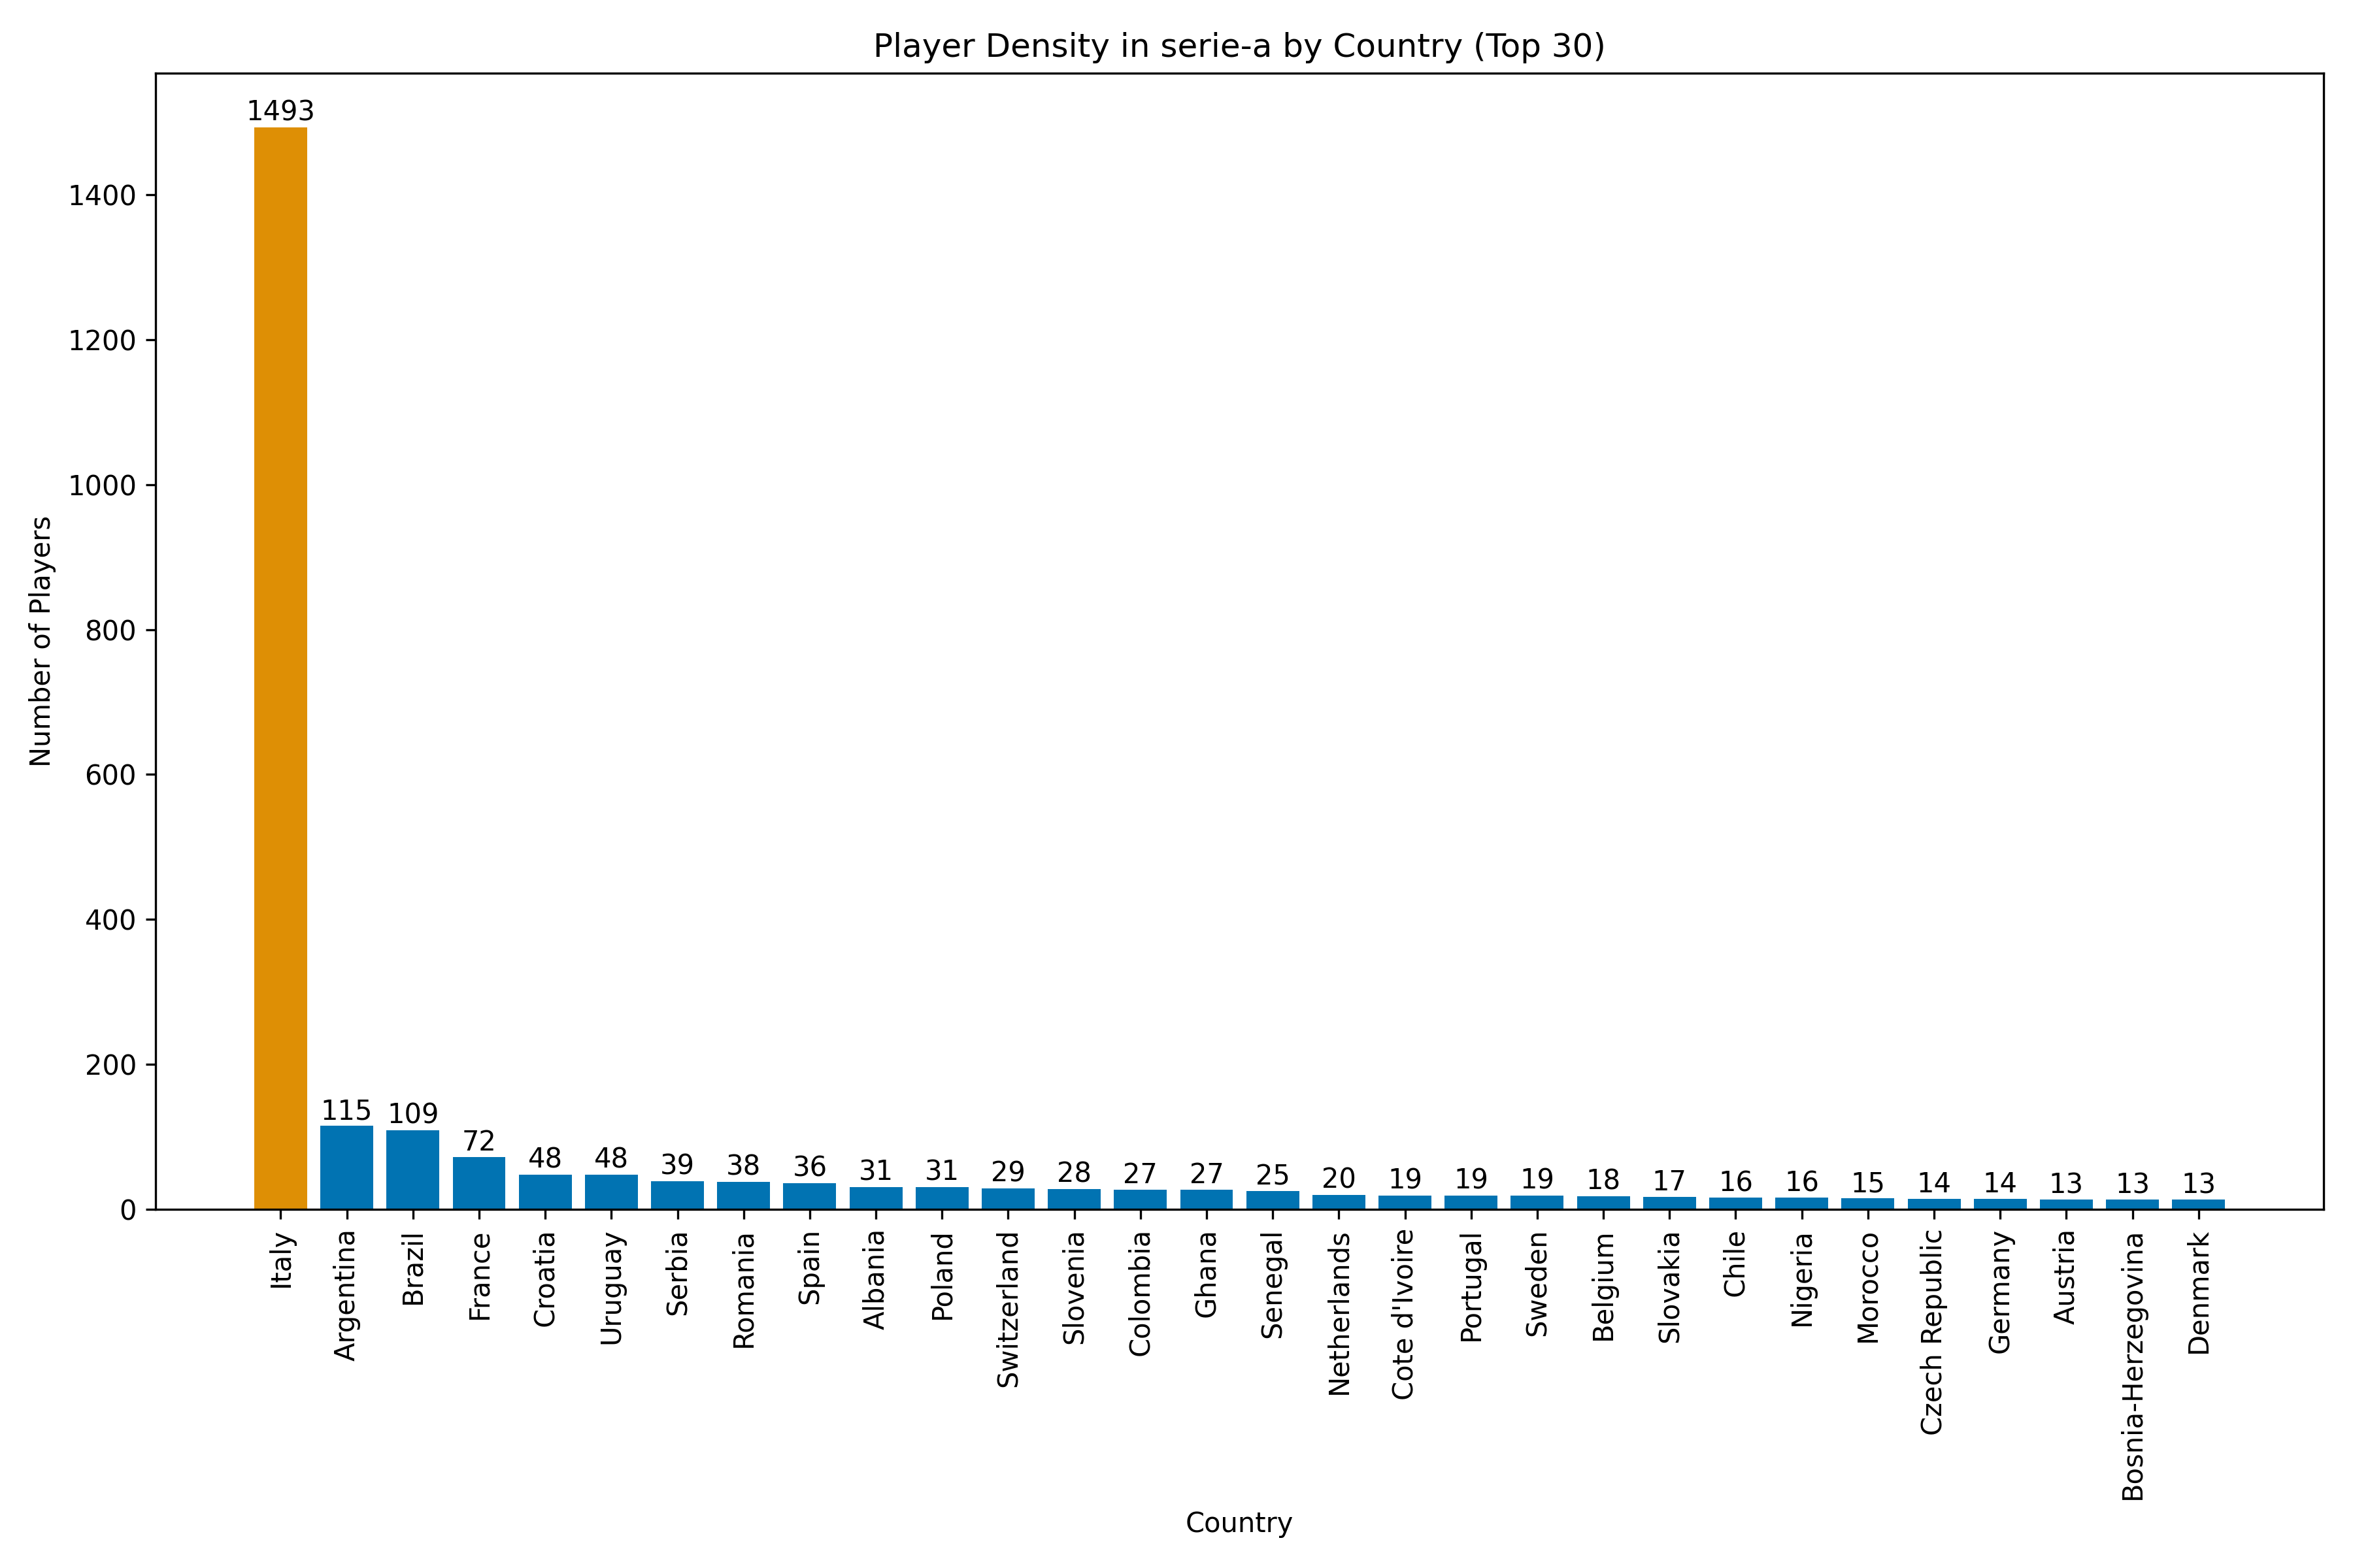

Notes:
The plot shows that the majority of players in Serie A are from Italy, followed by Argentina, Brazil, France, and Croatia.
Italy has the most players in Serie A. because it is Italian Football Championship
Argentina, Brazil, and France are also well-represented in Serie A. These countries are known for producing some of the best players in the world, and it is no surprise that they have a large number of players in Serie A.

Slide 10
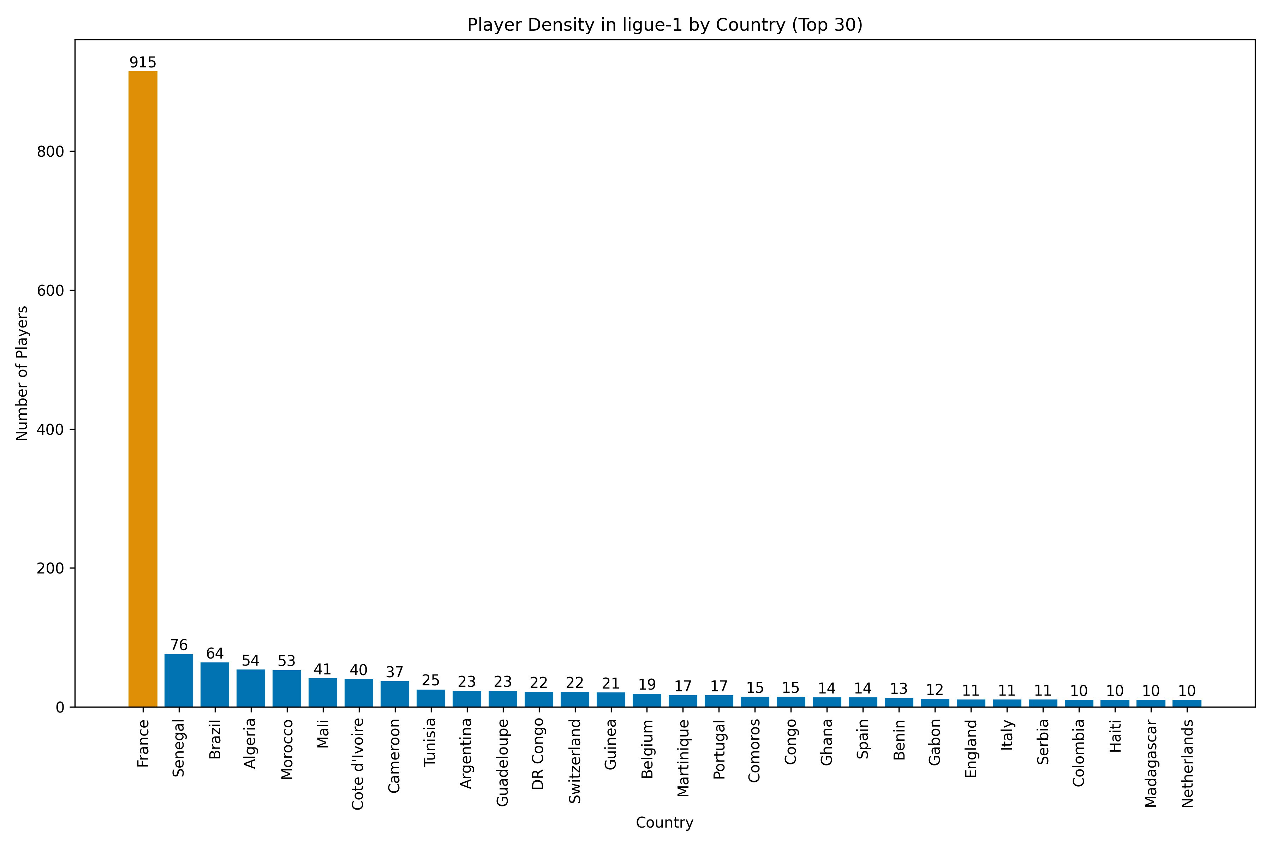

Notes:
The African continent is well-represented in Ligue 1. The top 10 countries by player density include four African countries: Senegal, Algeria, Morocco, and Ivory Coast. This suggests that Ligue 1 is a popular destination for African players.
There is a strong connection between France and its former colonies. strong historical and cultural connection between France and these countries, which may make it easier for players from these countries to integrate into French culture and Ligue 1.

Slide 11
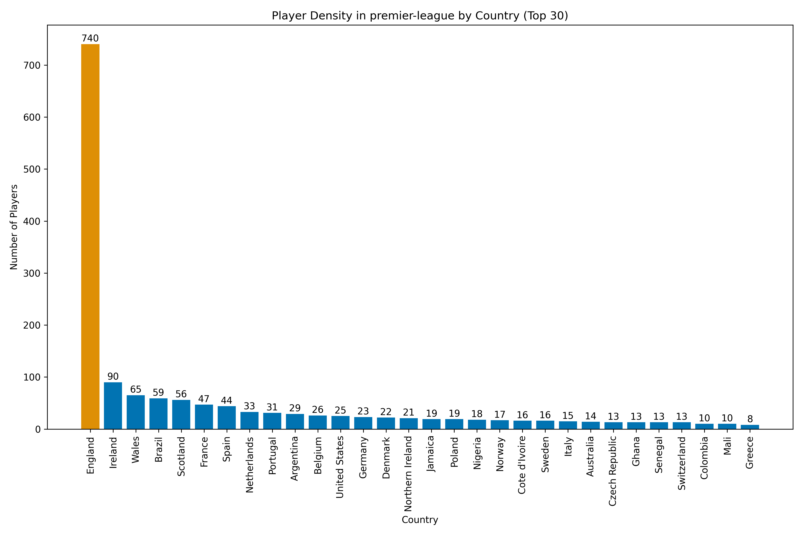

Notes:
Brazil is a major producer of talented footballers.
The Premier League is becoming more international. The number of players from non-European countries has been increasing in recent years.
The Premier League is a more diverse league than some other European leagues, such as Serie A. For example, the top 5 nationalities account for over 80% of all players in Serie A.
The Premier League is a very competitive league, and players from all over the world are attracted to the league by the prospect of playing against the best players in the world.

Slide 12
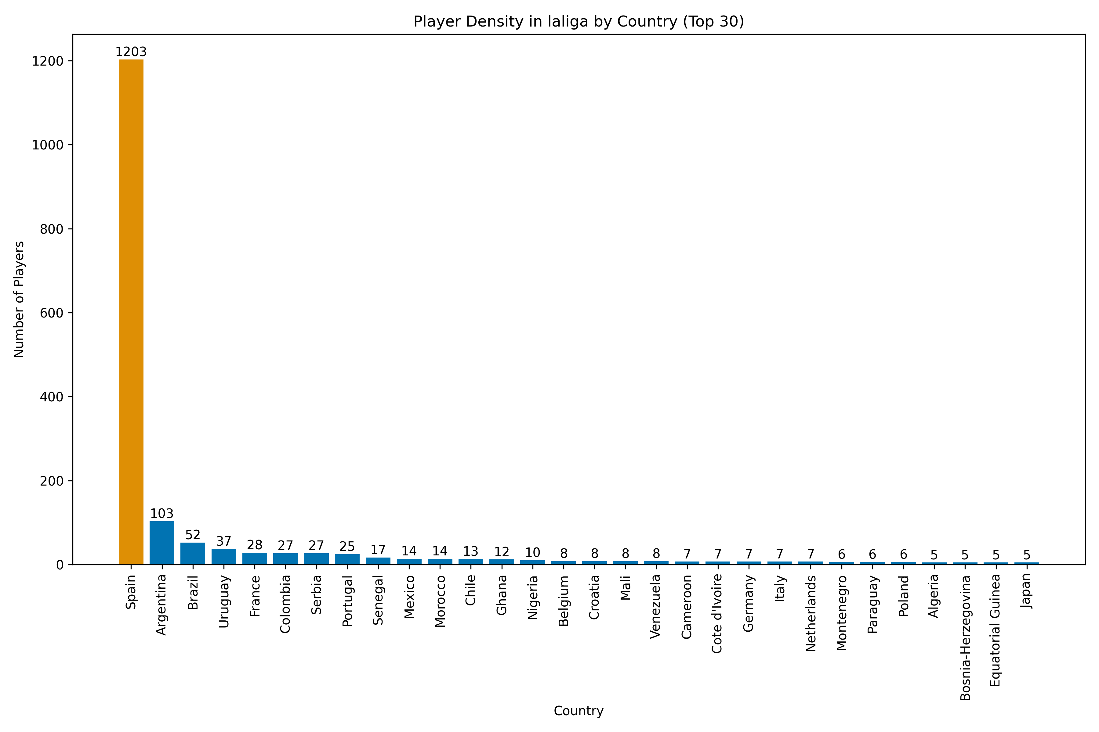

Notes:
La Liga is the top league in Spain,,, Spain has the most players in La Liga
South America was colonized by Spain and Portugal, which resulted in the spread of the Spanish and Portuguese languages and cultures throughout the region.

Slide 13
THANK YOU FOR LISTENING
DO YOU HAVE ANY QUESTIONS?
190ibrahimahmed@gmail.com
https://190ibrahim.github.io/My-Portfolio/
CITING:
title: transfermarkt-datasets
url: github.com/dcaribou/transfermarkt-datasets
author: @dcaribou

